Slide 1
Learning with Prototypes
CS771: Introduction to Machine Learning
Purushottam Kar

Slide 2

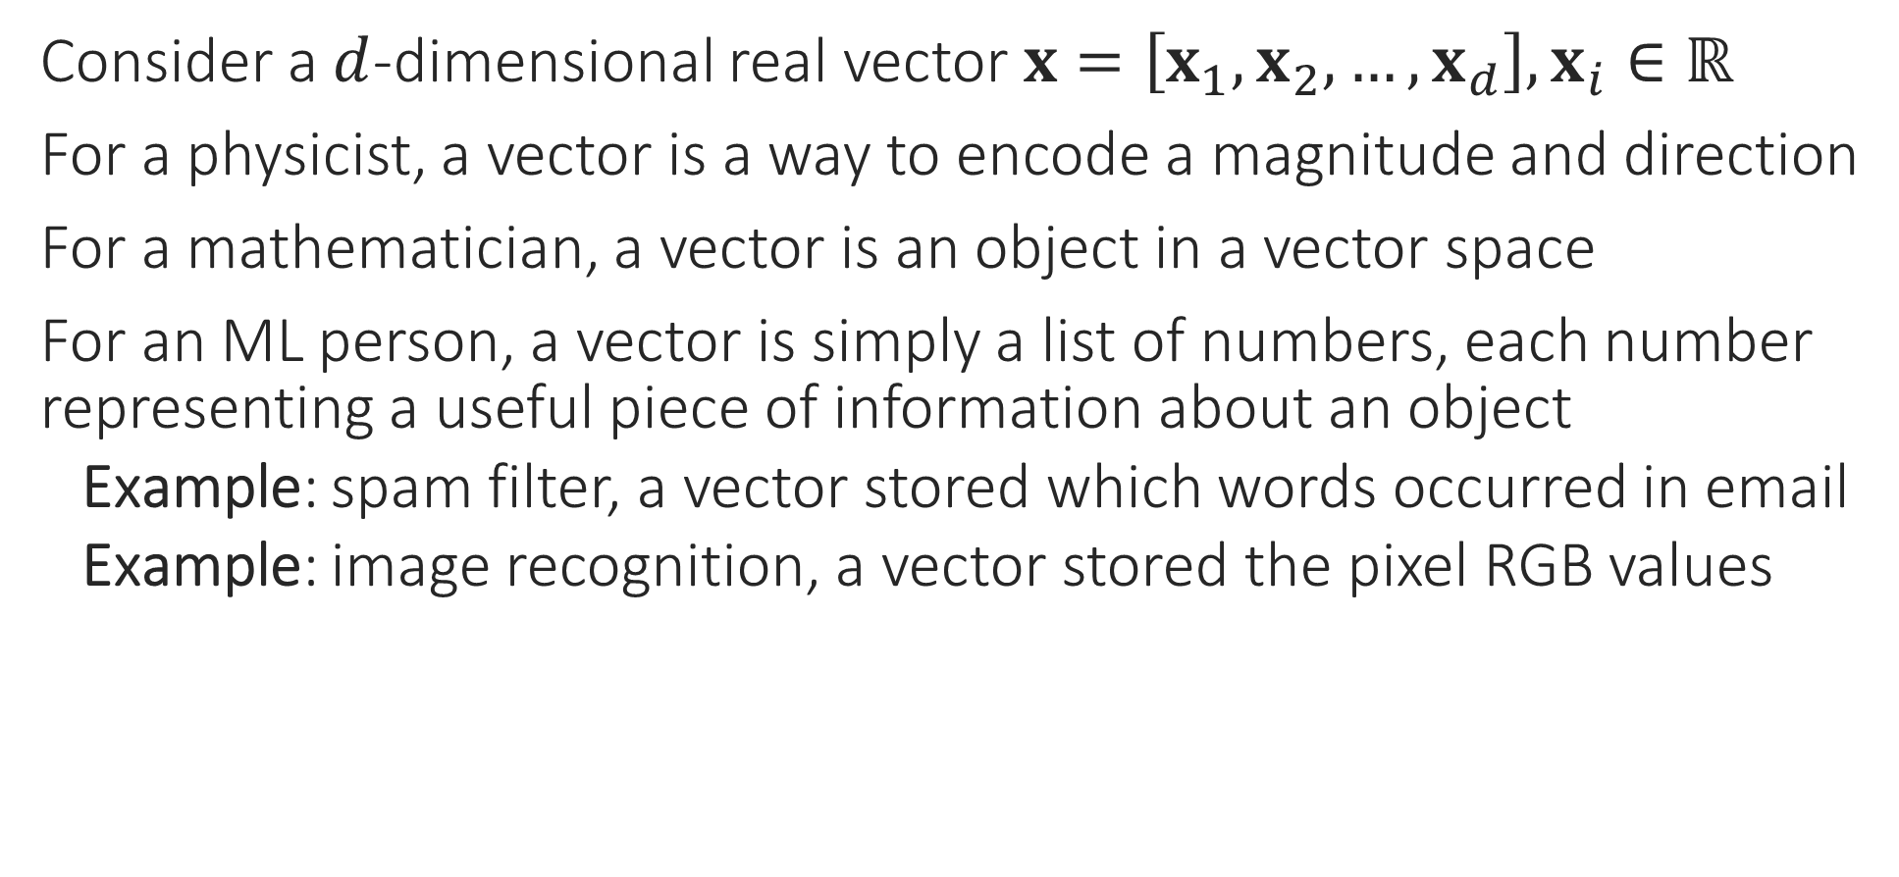
What are Vectors
Consider a $d$-dimensional real vector $x=\left[x_{1},x_{2},…,x_{d}\right],x_{i}∈ℝ$
For a physicist, a vector is a way to encode a magnitude and direction
For a mathematician, a vector is an object in a vector space
For an ML person, a vector is simply a list of numbers, each number representing a useful piece of information about an object
Example: spam filter, a vector stored which words occurred in email
Example: image recognition, a vector stored the pixel RGB values
Does this mean I will have to learn math to do ML?
A bit of math will be required but 1) it will be simple and 2) it will be totally worth it!
True, for me, vectors are just like arrays of numbers. However, sometimes I do indeed do math with them

Slide 3

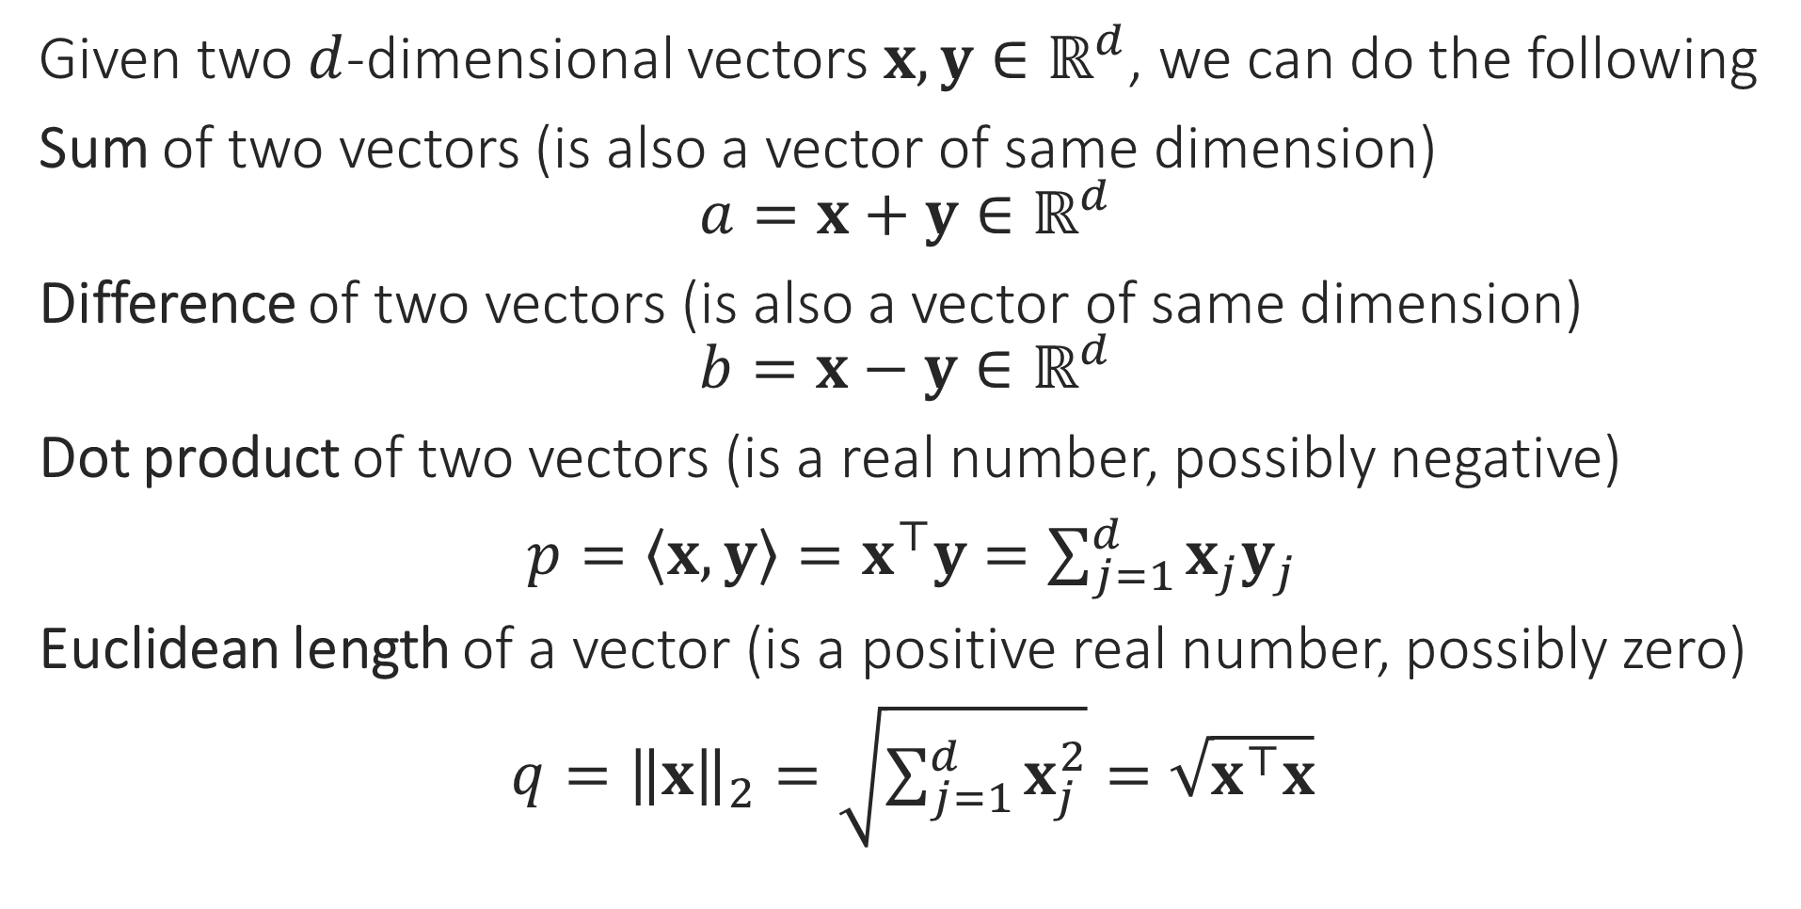
Operations on Vectors
Given two $d$-dimensional vectors $x,y∈ℝ^{d}$, we can do the following
Sum of two vectors (is also a vector of same dimension)
$$a=x+y∈ℝ^{d}$$
Difference of two vectors (is also a vector of same dimension)
$$b=x−y∈ℝ^{d}$$
Dot product of two vectors (is a real number, possibly negative)
$p=\left\langle x,y\right\rangle =x^{⊤}y=\sum_{j=1}^{d}{x_{j}y_{j}}$
Euclidean length of a vector (is a positive real number, possibly zero)
$q={\left\|x\right\|}_{2}=\sqrt{\sum_{j=1}^{d}{x_{j}^{2}}}=\sqrt{x^{⊤}x}$
Good point – just wait a second for some intuition. However, to be honest, sometimes it is good in ML not to hunt too much for intuition and just let the math be!
So I can take two feature vectors and add them. But what sense does it make to add two emails?

Slide 4



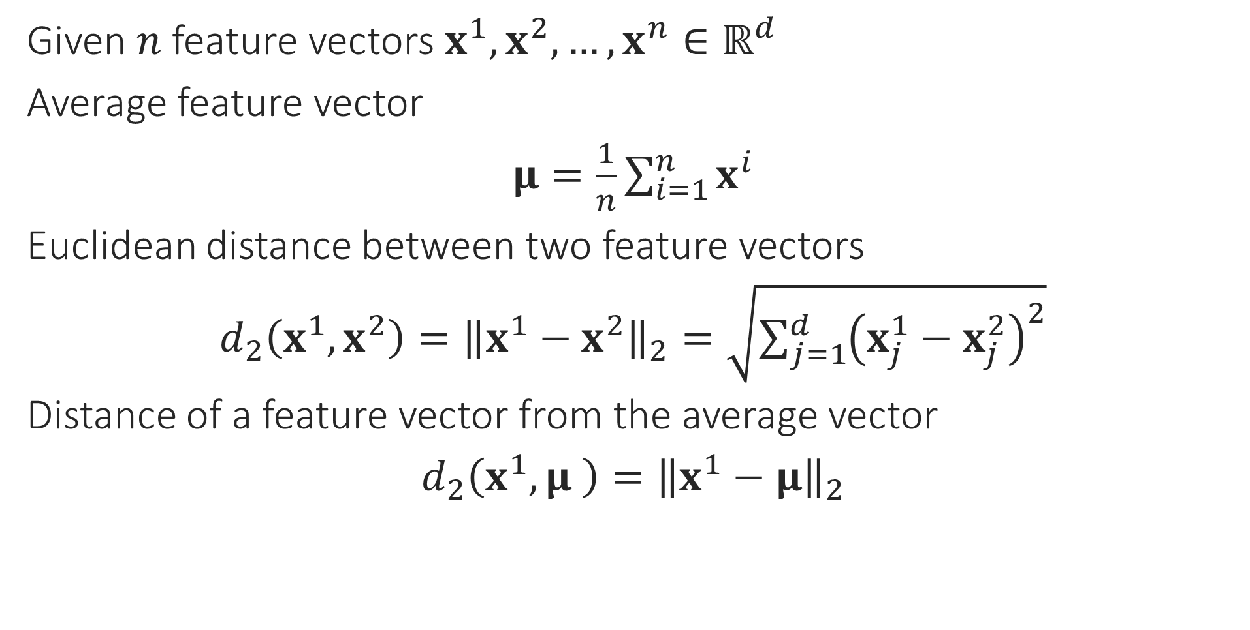
ML Operations on Feature Vectors
I can use this to find out what an “average” email looks like ☺. So averaging vectors makes sense!
Given $n$ feature vectors $x^{1},x^{2},…,x^{n}∈ℝ^{d}$
Average feature vector
$μ=\frac{1}{n}\sum_{i=1}^{n}{x^{i}}$
Euclidean distance between two feature vectors
$d_{2}\left(x^{1},x^{2}\right)={\left\|x^{1}−x^{2}\right\|}_{2}=\sqrt{{\sum_{j=1}^{d}{\left(x_{j}^{1}−x_{j}^{2}\right)}}^{2}}$
Distance of a feature vector from the average vector
$d_{2}\left(x^{1},μ \right)={\left\|x^{1}−μ\right\|}_{2}$
I can use this to find out if two emails are similar or very different from each other
I can use this to find out if a new email is similar to an average spam email or an average regular email
Excellent! We are now ready for our first ML algorithm!!

Slide 5
Learning with Prototypes
The basic mantra here is
If a new email looks similar to an average spam email, it may be a spam email. On the other hand, if a new email looks similar to an average normal email, it should be normal
In ML, the word prototype is used to refer to something that is representative or captures the qualities of a class of objects?
How can we do ML using prototypes?
“
“

Slide 6


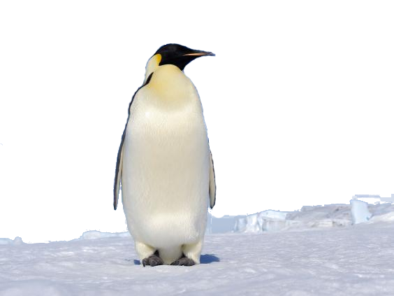
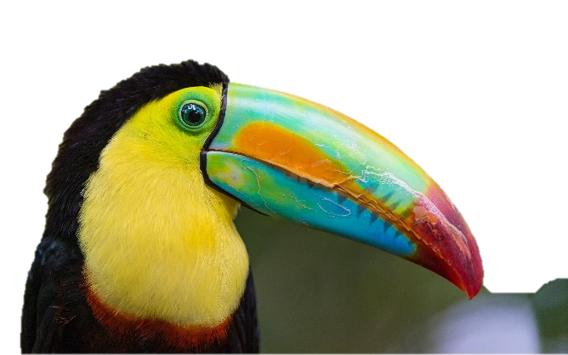
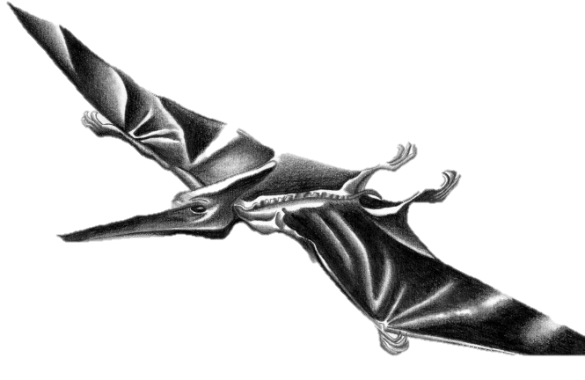
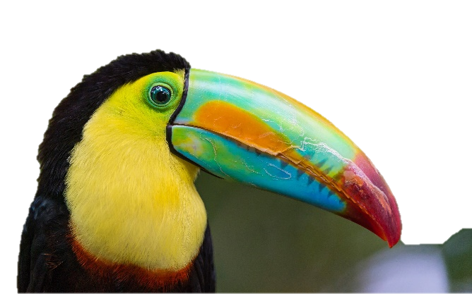



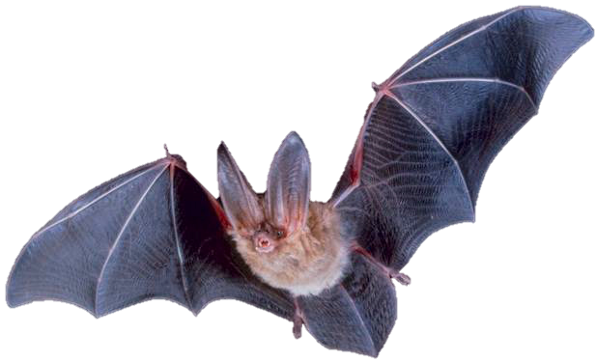

Bird or not!
But the Pterosaur will still get classified as a bird – it has wings and a beak
Important for deciding bird or not
Has wings
Can fly
Not that important for deciding bird or not
Can sing
This means that our prototype is not good enough and we may need better features
A prototypical bird!
Has a beak
What abstract qualities do we associate with “birdness”

Slide 7
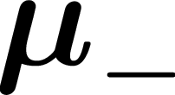
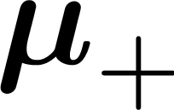





Learning with Prototypes
Feature vectors of normal emails
Prototype normal email
Feature vectors of spam emails
Wow! So so this is your model – just two vectors. You were able to distil all the information in the training emails into just two prototype vectors!!
Prototype spam email
In order to classify a new email as spam/non-spam I only need the two prototypes, not the training emails
In fact I can even handle cases where there are more than two classes e.g. instead of spam/non-spam, suppose the classes were Primary, Social, Updates …
This email is closer to the prototype spam email than the prototype normal email so I will classify this new email as spam!

Slide 8


Learning with Prototypes - Issues
If there is too much diversity in a class of objects, a single prototype may not be able to capture all the information
Yes, of course. But we will have to wait till we learn clustering before we can do so.
Normal work emails
Can we have two or more prototypes for the normal class?
Normal friend emails
What went wrong? The new email clearly resembled normal emails more than spam ones!

Slide 9

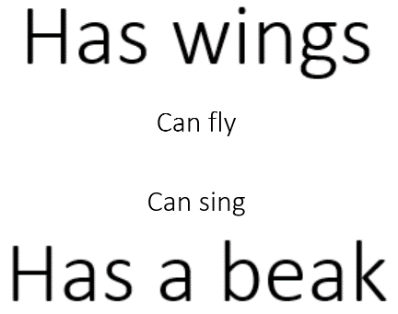
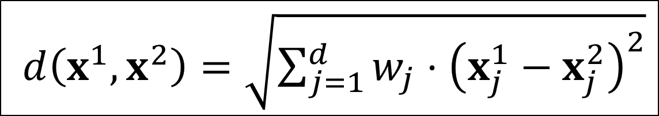
Learning with Prototypes - Issues
I think this time another issue is how we calculated distances. Can we use non-Euclidean distances?
What went wrong this time?
Can we learn these weights too?
Yes, but let us revisit this issue later
$d\left(x^{1},x^{2}\right)=\sqrt{{\sum_{j=1}^{d}{w_{j}⋅\left(x_{j}^{1}−x_{j}^{2}\right)}}^{2}}$
Well, notice that there is still a lot of intra-class diversity within the spam and the normal email classes
I think so too! E.g. we can give different weights to features while calculating distances

Slide 10
Learning with Prototypes - Lessons
An extremely simple technique to classify data
Can do binary classification (2-classes) as well as multi-classification
Very compact, light-weight model (one prototype per class)
Actually used in industrial applications like extreme classification
Actually state of the art if we have very few data points for a class
For example, if we have very few spam emails in training data
Works well when class data points are packed closely – less diversity
Improvements possible using multiple prototypes, metric learning (using a non-Euclidean distance function)

Slide 11
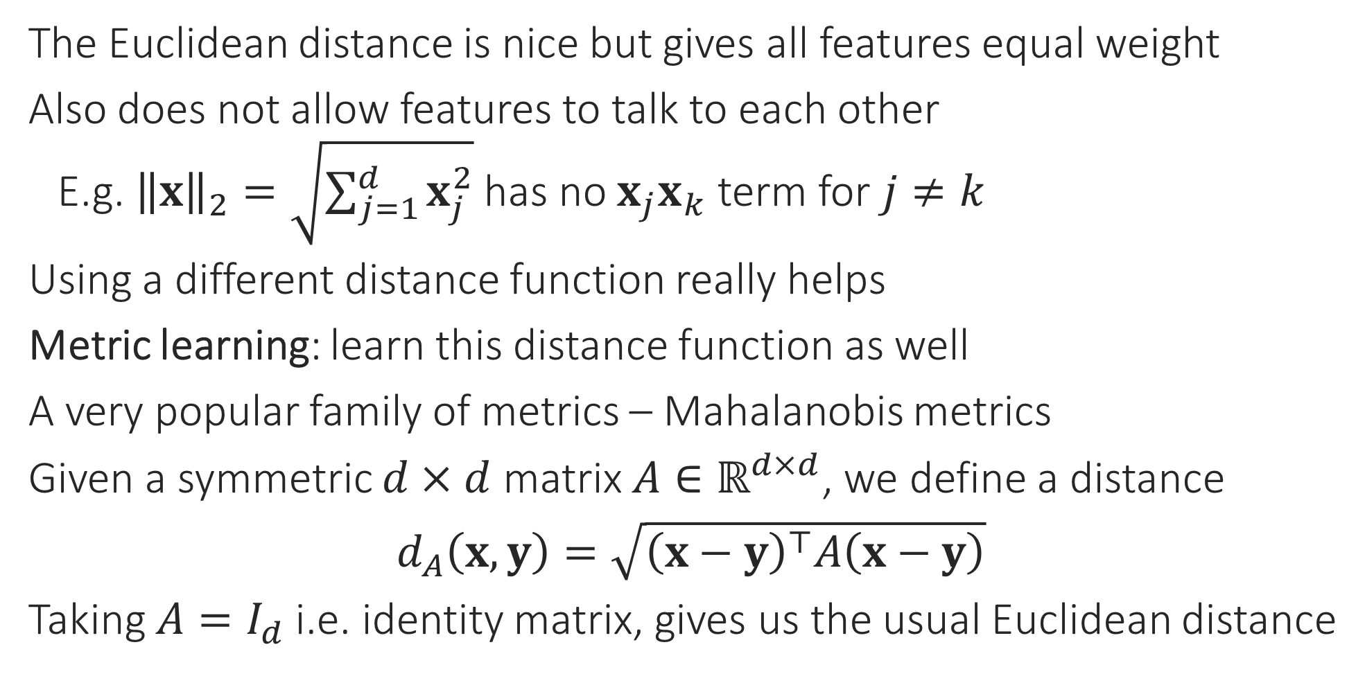
Making LwP more Powerful
The Euclidean distance is nice but gives all features equal weight
Also does not allow features to talk to each other
E.g. ${\left\|x\right\|}_{2}=\sqrt{\sum_{j=1}^{d}{x_{j}^{2}}}$ has no $x_{j}x_{k}$ term for $j≠k$
Using a different distance function really helps
Metric learning: learn this distance function as well
A very popular family of metrics – Mahalanobis metrics
Given a symmetric $d×d$ matrix $A∈ℝ^{d×d}$, we define a distance
$d_{A}\left(x,y\right)=\sqrt{{\left(x−y\right)}^{⊤}A\left(x−y\right)}$
Taking $A=I_{d}$ i.e. identity matrix, gives us the usual Euclidean distance
Euclidean distance does not change even if axes are rotated

Slide 12
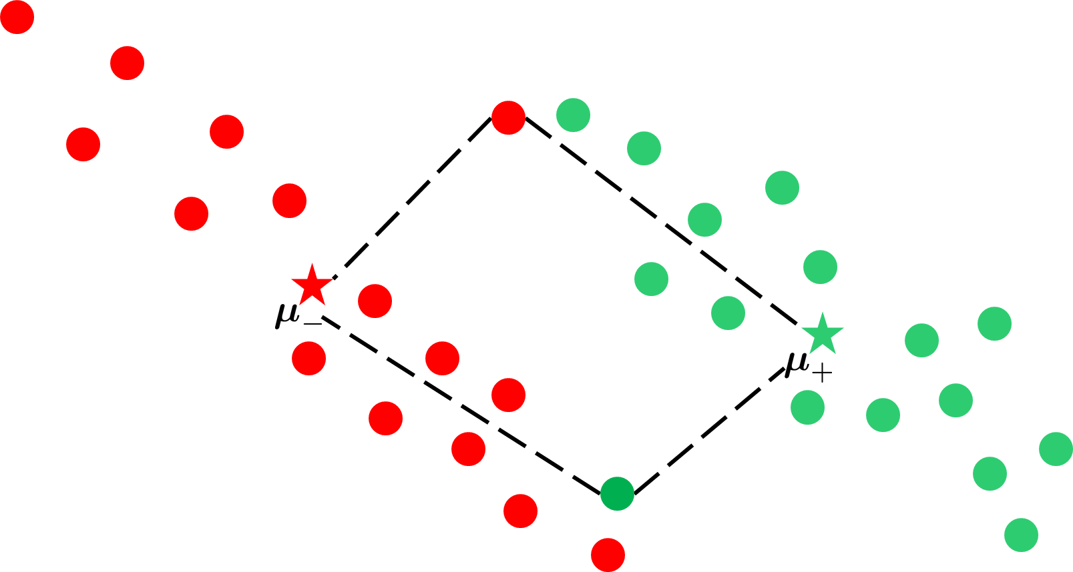
Why metric learning works

Slide 13

Why metric learning works
Metric learning allows you to effectively, deform the space. We can use such deformations to our advantage to bring certain points closer and push others apart.

Slide 14


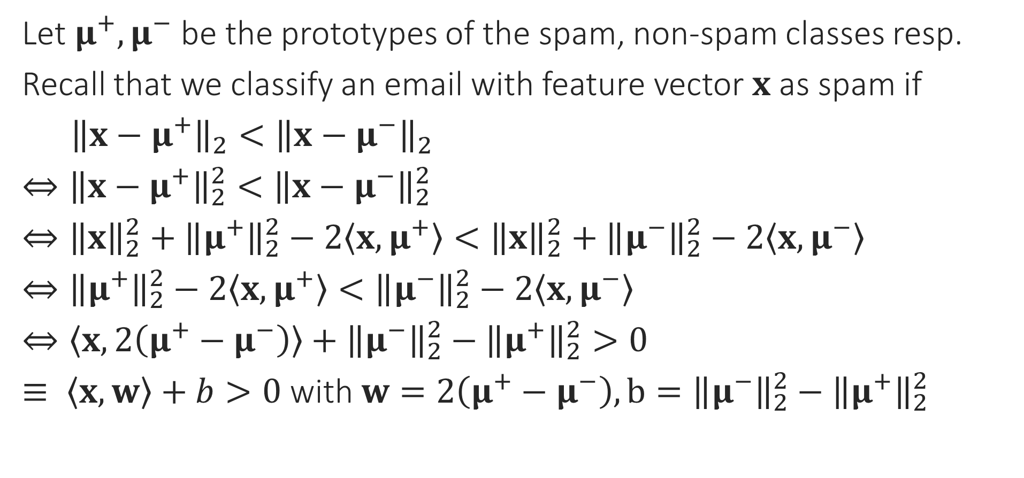
LwP – behind the scenes
Classifiers with linear decision boundaries are called linear classifiers. Thus, LwP is a linear classifier
Let $μ^{+},μ^{−}$ be the prototypes of the spam, non-spam classes resp.
Recall that we classify an email with feature vector $x$ as spam if
${\left\|x−μ^{+}\right\|}_{2}<{\left\|x−μ^{−}\right\|}_{2}$
$⇔{\left\|x−μ^{+}\right\|}_{2}^{2}<{\left\|x−μ^{−}\right\|}_{2}^{2}$
$⇔{\left\|x\right\|}_{2}^{2}+{\left\|μ^{+}\right\|}_{2}^{2}−2\left\langle x,μ^{+}\right\rangle <{\left\|x\right\|}_{2}^{2}+{\left\|μ^{−}\right\|}_{2}^{2}−2\left\langle x,μ^{−}\right\rangle$
$⇔{\left\|μ^{+}\right\|}_{2}^{2}−2\left\langle x,μ^{+}\right\rangle <{\left\|μ^{−}\right\|}_{2}^{2}−2\left\langle x,μ^{−}\right\rangle$
$⇔\left\langle x,2\left(μ^{+}−μ^{−}\right)\right\rangle +{\left\|μ^{−}\right\|}_{2}^{2}−{\left\|μ^{+}\right\|}_{2}^{2}>0$
$≡ \left\langle x,w\right\rangle +b>0$ with $w=2\left(μ^{+}−μ^{−}\right), b={\left\|μ^{−}\right\|}_{2}^{2}−{\left\|μ^{+}\right\|}_{2}^{2}$
What happens if there are 2 or more prototypes per class, or else if there are 3 classes?
Think about this on your own – will discuss later
Yes, this is known as a linear decision boundary.
So the decision boundary of the LwP classifier is always a line or a hyperplane if the distance function is Euclidean!!

Slide 15

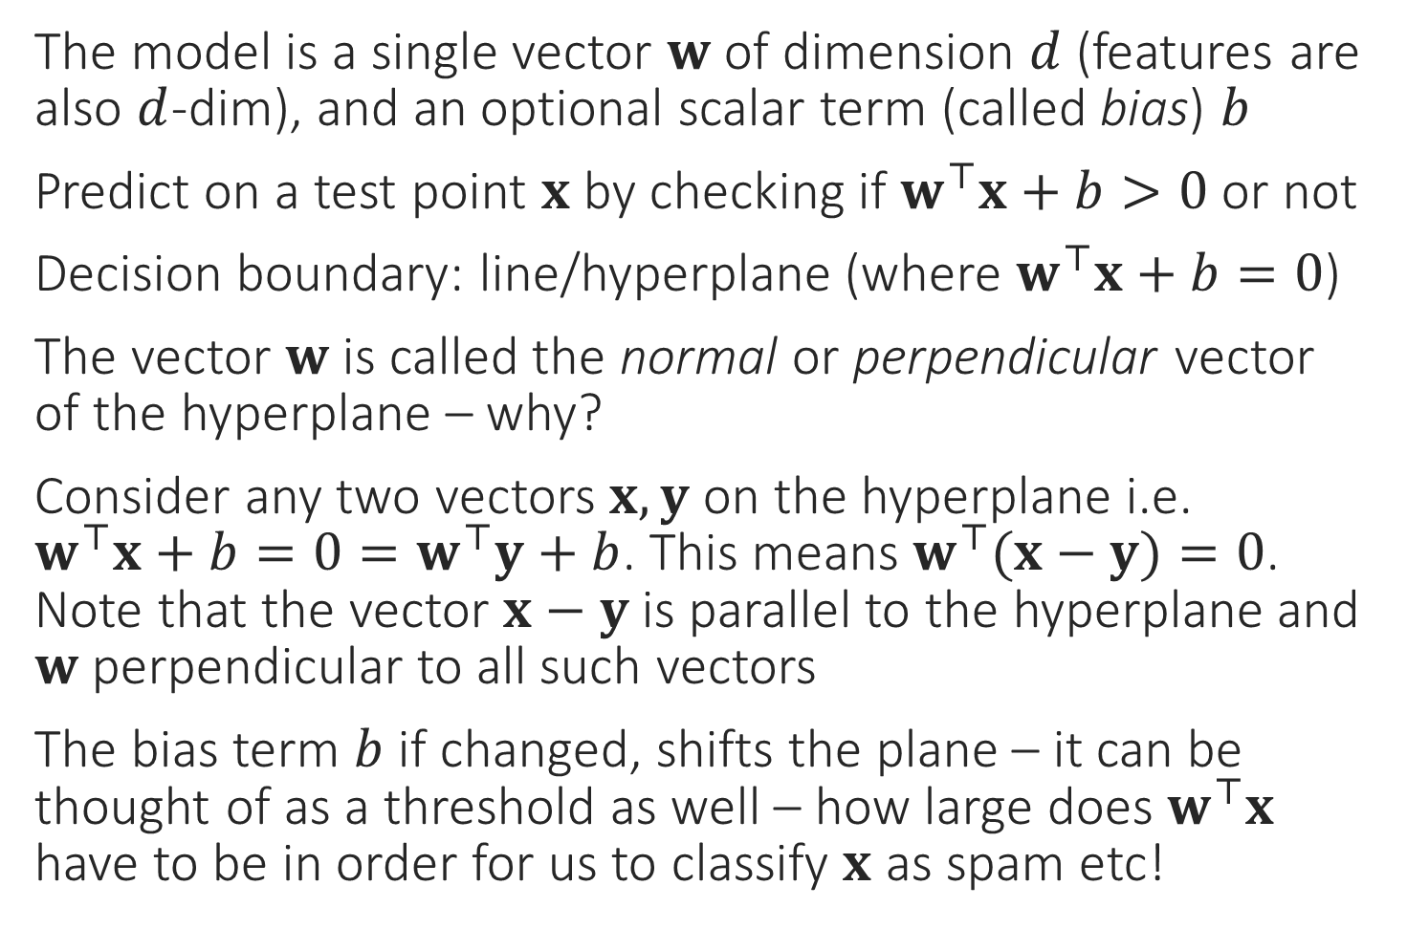
Linear/hyperplane Classifiers
The model is a single vector $w$ of dimension $d$ (features are also $d$-dim), and an optional scalar term (called bias) $b$
Predict on a test point $x$ by checking if $w^{⊤}x+b>0$ or not
Decision boundary: line/hyperplane (where $w^{⊤}x+b=0$)
The vector $w$ is called the normal or perpendicular vector of the hyperplane – why?
Consider any two vectors $x,y$ on the hyperplane i.e. $w^{⊤}x+b=0=w^{⊤}y+b$. This means $w^{⊤}(x−y)=0$. Note that the vector $x−y$ is parallel to the hyperplane and $w$ perpendicular to all such vectors
The bias term $b$ if changed, shifts the plane – it can be thought of as a threshold as well – how large does $w^{⊤}x$ have to be in order for us to classify $x$ as spam etc!
$$w$$

Slide 16
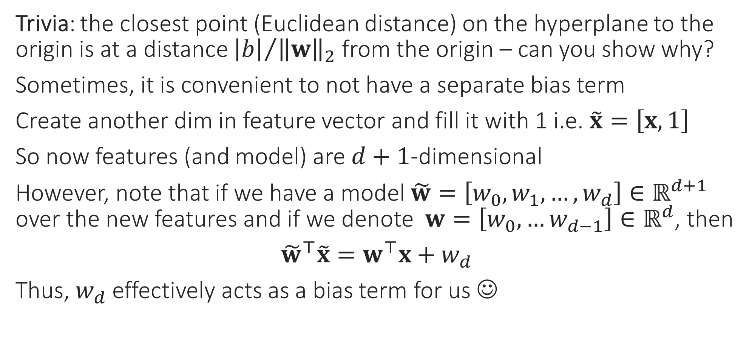

To $b$ or not to $b$ – that is the question!
Trivia: the closest point (Euclidean distance) on the hyperplane to the origin is at a distance ${\left|b\right|}/{{\left\|w\right\|}_{2}}$ from the origin – can you show why?
Sometimes, it is convenient to not have a separate bias term
Create another dim in feature vector and fill it with 1 i.e. $\tilde{x}=\left[x,1\right]$
So now features (and model) are $d+1$-dimensional
However, note that if we have a model $\tilde{w}=\left[w_{0},w_{1},…,w_{d}\right]∈ℝ^{d+1}$ over the new features and if we denote $w=\left[w_{0},…w_{d−1}\right]∈ℝ^{d}$, then
${\tilde{w}}^{⊤}\tilde{x}=w^{⊤}x+w_{d}$
Thus, $w_{d}$ effectively acts as a bias term for us ☺

Slide 17

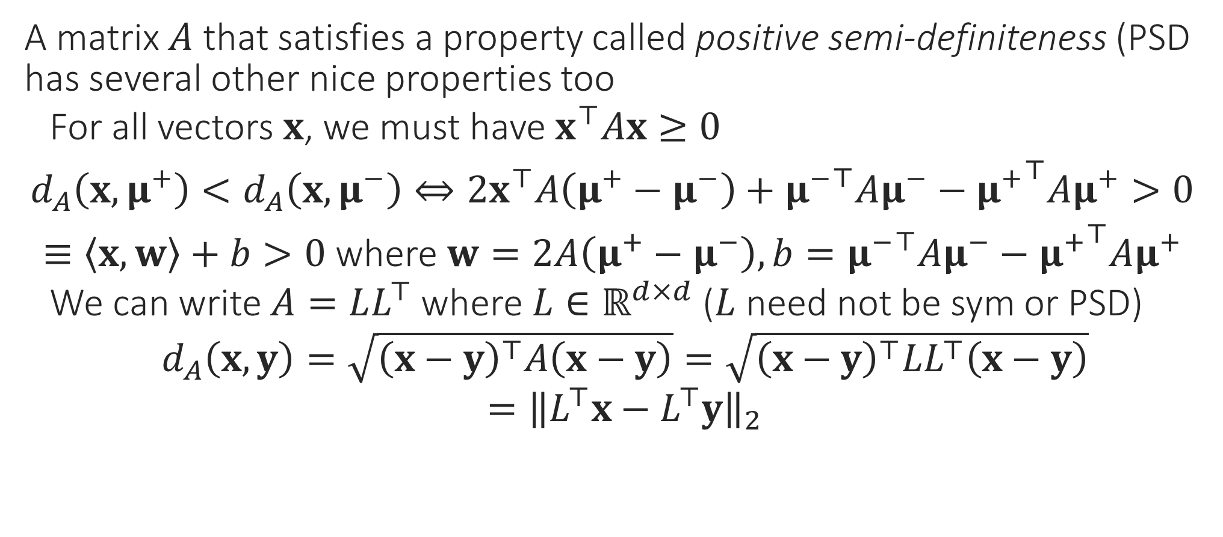
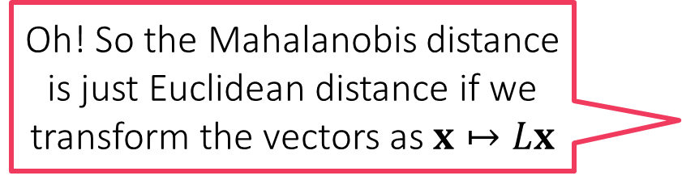
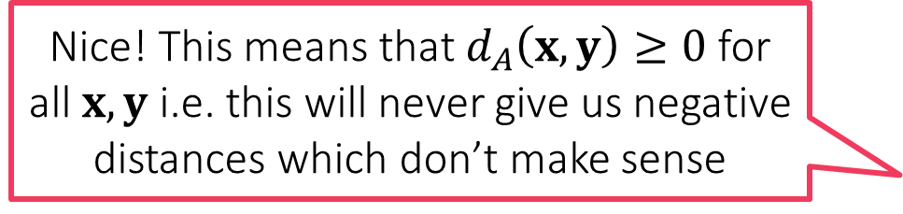
LwP with Mahalanobis metric still linear!!
A matrix $A$ that satisfies a property called positive semi-definiteness (PSD has several other nice properties too
For all vectors $x$, we must have $x^{⊤}Ax≥0$
$d_{A}\left(x,μ^{+}\right)<d_{A}\left(x,μ^{−}\right)⇔2x^{⊤}A\left(μ^{+}−μ^{−}\right)+{μ^{−}}^{⊤}Aμ^{−}−{μ^{+}}^{⊤}Aμ^{+}>0$
$≡\left\langle x,w\right\rangle +b>0$ where $w=2A\left(μ^{+}−μ^{−}\right), b={μ^{−}}^{⊤}Aμ^{−}−{μ^{+}}^{⊤}Aμ^{+}$
We can write $A=LL^{⊤}$ where $L∈ℝ^{d×d}$ ($L$ need not be sym or PSD)
$d_{A}\left(x,y\right)=\sqrt{{\left(x−y\right)}^{⊤}A\left(x−y\right)}=\sqrt{{\left(x−y\right)}^{⊤}LL^{⊤}\left(x−y\right)}$
$={\left\|L^{⊤}x−L^{⊤}y\right\|}_{2}$
Nice! This means that $d_{A}\left(x,y\right)≥0$ for all $x,y$ i.e. this will never give us negative distances which don’t make sense
Oh! So the Mahalanobis distance is just Euclidean distance if we transform the vectors as $x↦Lx$

